Slide 1
MACs based on Hash Functions, Block Ciphers
Prepared by:
Kaustubh Wade (160410116060)
Naisargi Kothari (160410116051)
Vismay Lad (160410116052)
Bhavikkumar Machhi (160410116054)

Slide 2
MACs based on Hash Functions: HMAC
A hash function such as SHA was not designed for use as a MAC and cannot be used directly for that purpose, because it does not rely on a secret key.
There have been a number of proposals for the incorporation of a secret key into an existing hash algorithm. The approach that has received the most support is HMAC [BELL96a, BELL96b]. HMAC has been issued as RFC 2104, has been chosen as the mandatory-to-implement MAC for IP security, and is used in other Internet protocols, such as SSL. HMAC has also been issued as a NIST standard (FIPS 198).

Slide 3
HMAC Design Objectives
To use, without modifications, available hash functions. In particular, to use hash functions that perform well in software and for which code is freely and widely available.
To allow for easy replaceability of the embedded hash function in case faster or more secure hash functions are found or required.
To preserve the original performance of the hash function without incurring a significant degradation.
To use and handle keys in a simple way.
To have a well understood cryptographic analysis of the strength of the authentication mechanism based on reasonable assumptions about the embedded hash function.

Slide 4
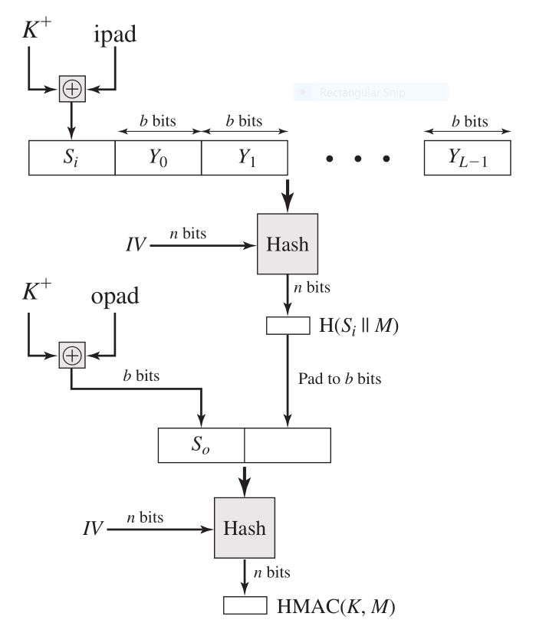
HMAC Structure

Slide 5
HMAC Algorithm
Append zeros to the left end of K to create a b-bit string K⁺ (e.g., if K is of length 160 bits and b = 512, then K will be appended with 44 zeroes).
XOR (bitwise exclusive-OR) K⁺ with ipad to produce the b-bit block S_{i.}
Append M to S_{i}.
Apply H to the stream generated in step 3.
XOR K⁺ with opad to produce the b-bit block S_{0.}
Append the hash result from step 4 to S_{0.}
Apply H to the stream generated in step 6 and output the result.

Slide 6
Terms Definition
H = embedded hash function (e.g., MD5, SHA-1, RIPEMD-160)
IV = initial value input to hash function
M = message input to HMAC (including the padding specified in the embedded
hash function)
Y^{i} = i^{th} block of M, 0 … i … (L - 1)
L = number of blocks in M
b = number of bits in a block

Slide 7
Terms Definition
n = length of hash code produced by embedded hash function
K = secret key; recommended length is Ú n; if key length is greater than b, the
key is input to the hash function to produce an n-bit key
K⁺ = K padded with zeros on the left so that the result is b bits in length
ipad = 00110110 (36 in hexadecimal) repeated b/8 times
opad = 01011100 (5C in hexadecimal) repeated b/8 times

Slide 8
Efficient Implementation
A more efficient implementation is possible. Two quantities are precomputed:
f(IV, (K + ⊕ ipad))
f(IV, (K + ⊕ opad))
where f(cv, block) is the compression function for the hash function, which takes as arguments a chaining variable of n bits and a block of b bits and produces a chaining variable of n bits.

Slide 9
Efficient Implementation
These quantities only need to be computed initially and every time the key changes. In effect, the precomputed quantities substitute for the initial value (IV) in the hash function. With this implementation, only one additional instance of the compression function is added to the processing normally produced by the hash function. This more efficient implementation is especially worthwhile if most of the messages for which a MAC is computed are short.

Slide 10
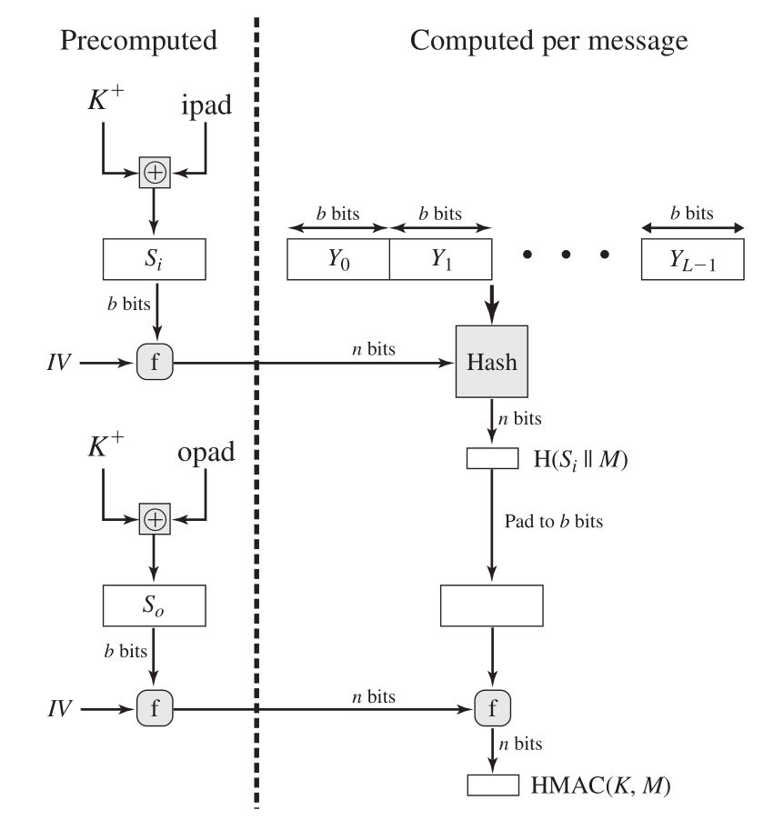
Efficient Implementation

Slide 11
MACs based on Block Ciphers: DAA & CMAC
We will look at two MACs that are based on the use of a block cipher mode of operation. We begin with an older algorithm, the Data Authentication Algorithm (DAA), which is now obsolete. Then we examine CMAC, which is designed to overcome the deficiencies of DAA.

Slide 12
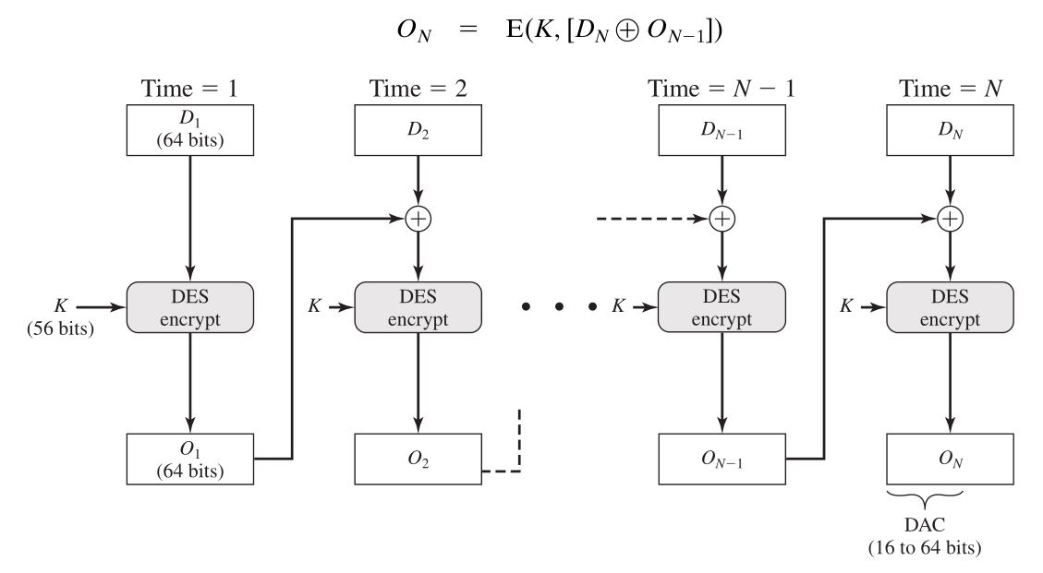
Data Authentication Algorithm(DAA)

Slide 13
Data Authentication Algorithm(DAA)
The Data Authentication Algorithm (DAA), based on DES, has been one of the most widely used MACs for a number of years. The algorithm is both a FIPS publication (FIPS PUB 113) and an ANSI standard (X9.17). However, as we discuss subsequently, security weaknesses in this algorithm have been discovered, and it is being replaced by newer and stronger algorithms. The algorithm can be defined as using the cipher block chaining (CBC) mode of operation of DES with an initialization vector of zero. The data (e.g., message, record, file, or program) to be authenticated are grouped into contiguous 64-bit blocks: D₁ , D₂, …, D_{n}.

Slide 14
Data Authentication Algorithm(DAA)
If necessary, the final block is padded on the right with zeroes to form a full 64-bit block.
O₁ = E(K, D)
O₂ = E(K, [D₂ ⊕ O₁ ])
O₃ = E(K, [D₃ ⊕ O₂ ])
...
O_{N} = E(K, [D_{n} ⊕ O_{N-1} ])
The DAC consists of either the entire block O_{N} or the leftmost M bits of the block, with 16 … M … 64. = E(K, [D N ⊕ O N-1 ])

Slide 15
Cipher-Based Message Authentication(CMAC)
As was mentioned, DAA has been widely adopted in government and industry. [BELL00] demonstrated that this MAC is secure under a reasonable set of security criteria, with the following restriction. Only messages of one fixed length of mn bits are processed, where n is the cipher block size and m is a fixed positive integer. As a simple example, notice that given the CBC MAC of a one-block message X, say T = MAC(K, X), the adversary immediately knows the CBC MAC for the two block message X}(X ⊕ T) since this is once again T.

Slide 16
Cipher-Based Message Authentication(CMAC)
Black and Rogaway [BLAC00] demonstrated that this limitation could be overcome using three keys: one key K of length k to be used at each step of the cipher block chaining and two keys of length b, where b is the cipher block length. This proposed construction was refined by Iwata and Kurosawa so that the two n-bit keys could be derived from the encryption key, rather than being provided separately [IWAT03]. This refinement, adopted by NIST, is the Cipher-based Message Authentication Code (CMAC) mode of operation for use with AES and triple DES. It is specified in NIST Special Publication 800-38B.

Slide 17
Cipher-Based Message Authentication(CMAC)
First, let us define the operation of CMAC when the message is an integer multiple n of the cipher block length b. For AES, b = 128, and for triple DES, b = 64. The message is divided into n blocks (M₁, M₂ , …, M_{N}). The algorithm makes use of a k-bit encryption key K and a b-bit constant, K₁. For AES, the key size k is 128, 192, or 256 bits; for triple DES, the key size is 112 or 168 bits.

Slide 18
Cipher-Based Message Authentication(CMAC)
CMAC is calculated as follows.
C₁ = E(K, M₁ )
C₂ = E(K, [M₂ ⊕ C₁ ])
C₃ = E(K, [M₃ ⊕ C₂ ])
…
C_{n} = E(K, [M n ⊕ C_{n-1} ⊕ K₁ ])
T = MSB Tlen (C n )
where
T = message authentication code, also referred to as the tag
Tlen = bit length of T
MSB_{s} (X) = the s leftmost bits of the bit string X

Slide 19
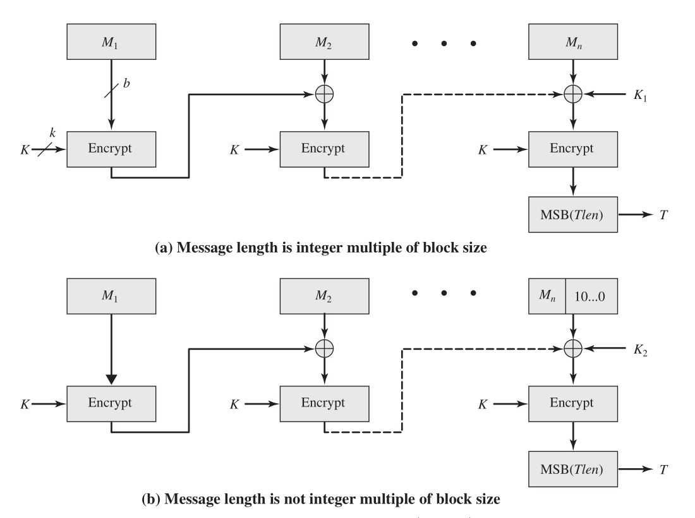
Cipher-Based Message Authentication(CMAC)

Slide 20
Cipher-Based Message Authentication(CMAC)
If the message is not an integer multiple of the cipher block length, then the final block is padded to the right (least significant bits) with a 1 and as many 0s as necessary so that the final block is also of length b. The CMAC operation then proceeds as before, except that a different b-bit key K 2 is used instead of K 1 .
The two b-bit keys are derived from the k-bit encryption key as follows.
L = E(K, 0^{b} )
K 1 = L . x
K 2 = L . x² = (L . x) . x

